Slide 1
Changing Geopolitical dynamics in the Asia-Pacific Region
An emerging economic partnership between India and Chile
S. K. Mohanty
Pankhuri Gaur
Webinar
Geopolitics of the Asia-Pacific and Challenges for Chile’s Foreign and Trade Policy
Organized by
Chile Pacific Foundation
15 May 2024

Slide 2
introduction
Asia-Pacific as hub of activities: Emerging Centre for strategic and economic activities
Augmented economic activities associated with different sources of conflicts
Growing conflict - mostly on controlling economic power
Conflicts in other religions affecting activities in the Asia Pacific region
Rise of Mega regionals- the building of exclusive economic conclaves- CPTPP, RCEP, IPEF, etc.
Countries like India and Chile find their way in balancing with major powers
Focus:
Chile’s pattern of trade with the Asia-Pacific region
Country’s trade in GVC
Chile and the Global South
India-Chile bilateral trade partnership

Slide 3
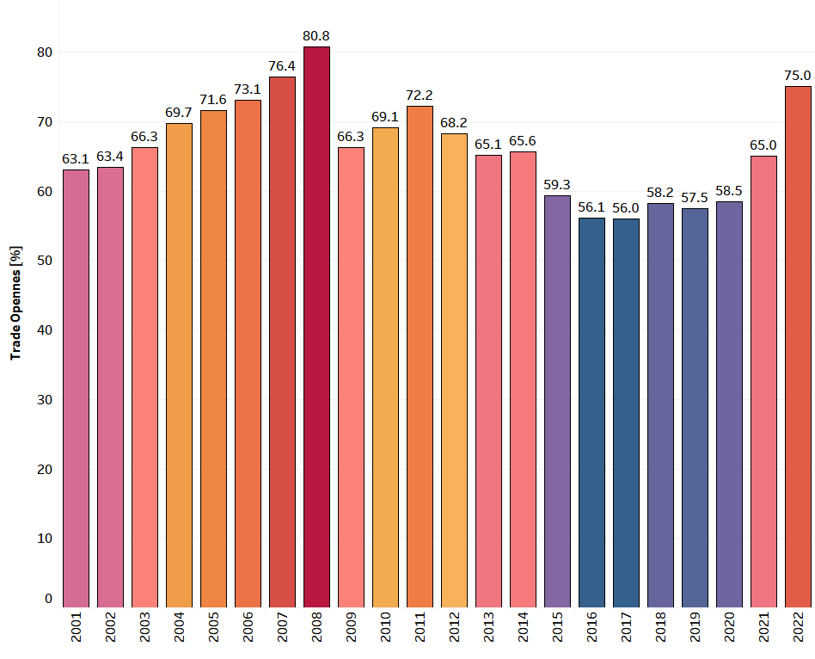
Global trade regimes and Chile’s Trade performance
Changing global trade regimes and performance of various regions
Trade policies for many countries shifted from ELG to DDLG
Few countries maintained high trade openness during global recession of 2008 - Chile
Buoyancy (2001-07) – high and growing
Recession (1st phase) – maintained
Recession (2nd phase) – low profile and growth in recent years
Trade Openness of Chile

Slide 4
Primary-based exports of chile
Chile’s Import basket – more diversified than export
Strong export presence in selected sectors – Minerals, Base Metals, Chemicals, & Agri.
Presence of Intra-industry trade – minerals, chemicals, base metals
As a member of the Cairns group – competitiveness in agri, except fats & oils
As an upper-middle income country, Intra-industry trade in food sector
Chile’s trade with the world, 2022 – by Section

Slide 5
Chile’s Shifting trade focus to the world
Trade destinations of Chile – radical shift in the last 50 years
Traditional partners – the US and the EU during 70s & 80s
Growing trade linkages with South America & Japan with traditional partners – 1990s
Trade flow with traditional partners – slowed & emergence of Asia Pacific – 2010s
Post-COVID – trade with the US further diluted

Slide 6
Asia Pacific: an emerging arena for trade
With traditional partners – trade slowed down
Increased trade with Central America & Pacific Alliance
Asia and Oceania – newly emerging trade space for Chile
In Asia-Pacific region – Chile mostly dependent on the US and China for imports
Exports – the US, China, Japan, South Korea and India
+

Slide 7
Chile’s trade with Asia Pacific vis-à-vis world
Pattern of regional trade geography of Chile – towards Asia – Pacific
Trade with Asia Pacific – defining Chile’s trade engagement with the world
Exports to Asia-Pacific – growing convergence
Imports from Asia-Pacific – followed the same path with the world

Slide 8
Intermediate trade of Chile with Asia Pacific
Share of Asia-Pacific in End-Use Trade of Chile, 2022
(% in Total Trade of Chile)
Global GVC Trade – growing and contributes 60-80% of global trade
Chile’s global trade – dominated by Intermediate goods in 2022
Semi-pro (35.3%) – major share
PnC (4.1%) – low
Final Goods (34%) – dominated by final consumer goods (23.9%)
Chile’s trade with Asia Pacific – 75.3% of total trade
Chile highly dependent on the region for exports (82.4%) and imports (68.7%)
In most of product segments – Chile’s dependence on Asia-Pacific – more than 70%, except primary imports, semi-pro imports & final capital goods exports
 | Imports | Exports | Tot Trade
Primary | 33.12 | 92.03 | 75.55
Semi-Proc | 62.45 | 81.41 | 74.39
PnC | 72.88 | 75.39 | 73.17
Capital | 73.06 | 58.34 | 72.40
Consumer | 72.05 | 73.31 | 72.60
Others | 98.75 | 56.18 | 95.94

Slide 9
Chile’s trade with the global south
Chile championing the causes of the Global South
Rise in trade – growing importance of trade with the South
4 trade regimes: North Vs South
1960-1975: low trade – mostly with North
1980-1985: moderate trade – moderate level of trade with the North
1990-2000: high trade – share of trade with North greater than the share of trade with South
2005-2022: period of great divide – increasing trade gap with North and South
(2005-2022)
(1990-2000)
(1980-1985)
(1960-1975)

Slide 10
Trends in Chile’s Trade with India
($ Million)
Chile’s exports to India – more volatile than imports
Exports adversely affected during 2nd phase of recession (2017-22)
Imports from India – growing steadily during the global recession
World price fluctuations affecting country’s export to India
Copper – major export item to India
Copper prices – persistent decline (2012-16), fluctuating (2017-20) & rising (2021-23)

Slide 11
Bilateral composition of sectoral trade
Chile’s exports to India: highly concentrated in 4 sectors
Minerals – dominated export profile
Fruits & Vegetables – highest exporting sector of agri
Chemicals – presence of Intra-industry trade
Wood Pulp
Chile’s imports from India: more diversified – 7 sectors
Auto – major concentration, Chemicals, textiles, machinery, base metals, plastics, leather, etc.

Slide 12
WAY Forward
As an emerging and open economy, Chile balances its political strategy with economic policies
Maintain the policy of growth with stability
Shifting economic space towards Asia-Pacific – focused on semi-processed and final consumer goods
Chile’s trade ties picking up with the Global South
India-Chile trade – moving towards convergence

Slide 13
Thank You

