Slide 1
Impact of Trade Fragmentation in the Asia-Pacific Region
The “Fragmentation” of International Trade:
Carlos Kuriyama
APEC Policy Support Unit
April 2024

Slide 2
China and the US are seeing lower market shares in each other’s imports
Bilateral goods imports between China and the US in 2014Q2-2023Q4
Source: APEC PSU calculations using data from the International Trade Centre (ITC) (accessed 19 March 2024).
Difference in average shares between 2014Q2-2018Q4 and 2019Q2-2023Q4
 | 2014Q2-2018Q4 (%) | 2019Q2-2023Q4 (%) | Difference (pp)
China share of US goods imports | 21.5 | 17.3 | -4.1
US share of China goods imports | 8.3 | 6.5 | -1.7

Slide 3
China lost >10pp of market share in US imports across 195 products*
Majority of these products are related to textiles, metals, and machines
Number of China products that lost >10pp of market share in US imports, by product category
Note: Based on the difference in average shares between 2014Q2-2018Q4 and 2019Q2-2023Q4. Number of goods calculated using HS 4-digit product headings.
Source: APEC PSU calculations using data from the ITC (accessed 19 March 2024).
*In comparison, the US lost >10pp of market share in China imports across 14 goods (without concentration in any product group).

Slide 4
But China gained >10pp of market share in US imports across 26 products*
Majority of these products are related to minerals, chemicals, and metals
Number of China products that gained >10pp of market share in US imports, by product category
Note: Based on the difference in average shares between 2014Q2-2018Q4 and 2019Q2-2023Q4. Number of goods calculated using HS 4-digit product headings.
Source: APEC PSU calculations using data from the ITC (accessed 19 March 2024).
*In comparison, the US gained >10pp of market share in China imports across 4 goods (without concentration in any product group).

Slide 5
China and the US are increasing trade with other partners
Certain economies saw increased market shares in either’s imports
Partner economies that gained or lost >0.5pp of market share, by reporting economy imports
(difference in average shares between 2014Q2-2018Q4 and 2019Q2-2023Q4)
Source: APEC PSU calculations using data from the ITC (accessed 19 March 2024).

Slide 6
Mexico gained >10pp of market share in US imports across 39 products*
Majority of these are related to metals, chemicals, and transportation
Number of Mexico products that gained >10pp of market share in US imports, by product category
Note: Based on the difference in average shares between 2014Q2-2018Q4 and 2019Q2-2023Q4. Number of goods calculated using HS 4-digit product headings.
Source: APEC PSU calculations using data from the ITC (accessed 19 March 2024).

Slide 7
Despite changes in trade, China and US FDI with each other proves sticky
Bilateral inward FDI stock between China and the US in 2014-2022
Source: APEC PSU calculations using data from the International Monetary Fund (IMF) (accessed 21 March 2024).
Difference in average shares between 2014-2017 and 2019-2022
 | 2014-2017 (%) | 2019-2022 (%) | Difference (pp)
China share of US inward FDI stock | 0.7 | 0.7 | 0.0
US share of China inward FDI stock | 2.9 | 2.5 | -0.4

Slide 8
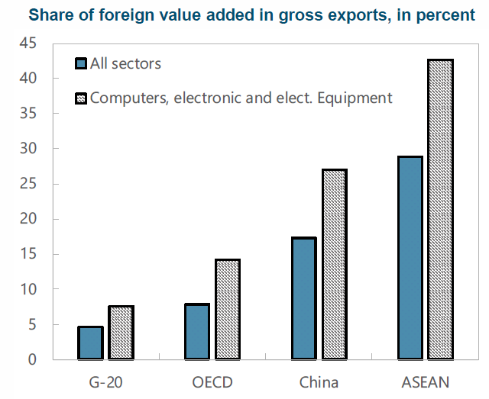
ASEAN is benefiting from developments in the last decade (1 of 4)
ASEAN has surpassed China both in greenfield FDI and foreign value-added
Market share of greenfield FDI projects between January 2003 and July 2022, by economy (%)
Share of foreign value-added in gross exports in 2015, by category (%)
Source: FDI Intelligence (https://www.fdiintelligence.com/content/news/developing-asia-to-grow-faster-than-china-for-first-time-in-30-years-81486)
Source: Lifted from Cerdeiro et al. (2021). (https://www.imf.org/en/Publications/WP/Issues/2021/03/12/Sizing-Up-the-Effects-of-Technological-Decoupling-50125)

Slide 9
ASEAN is benefiting from developments in the last decade (2 of 4)
The FDI gap between China and ASEAN has been narrowing
Total inward FDI stock, by economy
(billion USD)
Source economies that gained >0.5pp of market share in ASEAN inward FDI stock
Note: ASEAN inward FDI stock does not include Lao PDR; and Viet Nam due to data unavailability.
Source: APEC PSU calculations using data from the IMF (accessed 21 March 2024).
Note: Based on the difference in average shares between 2014-2017 and 2019-2022. Inward ASEAN FDI stock does not include Lao PDR; and Viet Nam due to data unavailability.
Source: APEC PSU calculations using data from the IMF (accessed 21 March 2024).

Slide 10
ASEAN is benefiting from developments in the last decade (3 of 4)
Many ASEAN economies have attracted greenfield FDI
Announced greenfield FDI in selected economies, January-June 2022 (million USD)
Source: FDI Intelligence (https://www.fdiintelligence.com/content/data-trends/singapore-leads-fdi-into-asean-in-2022-81509)

Slide 11
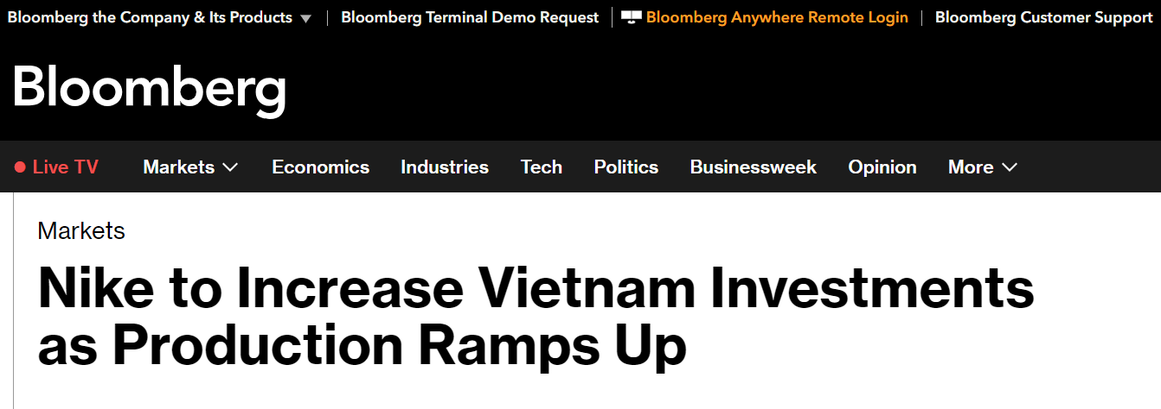
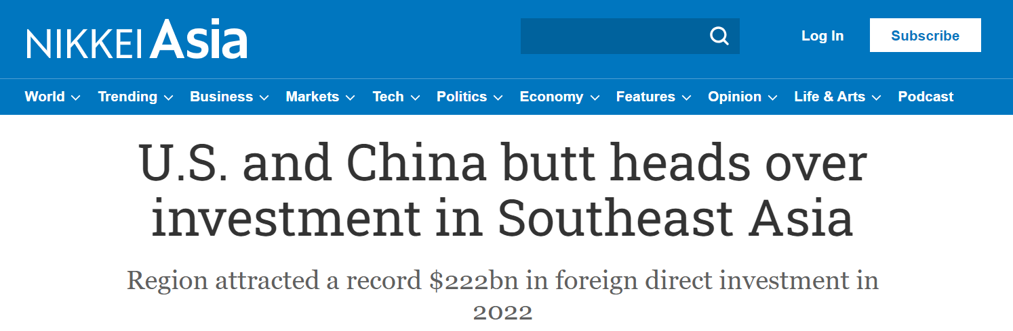
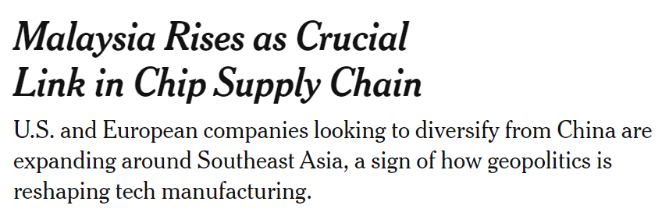
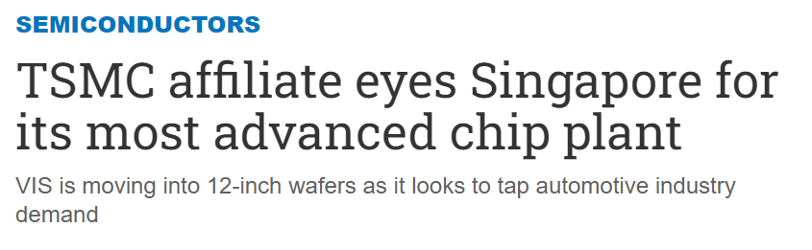
ASEAN is benefiting from developments in the last decade (4 of 4)
FDI in various sectors, including textiles, semiconductors, and electronics

Slide 12
Find out more about the APEC Policy Support Unit (PSU)
Website: www.apec.org/about-us/policy-support-unit
Email: psugroup@apec.org

