Slide 1
Challenges affecting SMEs in the Global Supply Chains
Carlos Kuriyama
Director, Policy Support Unit
APEC Secretariat
Webinar on Current Trends in Global Supply Chains: What is at Stake for Chile
Santiago, Chile • 27 November 2023

Slide 2
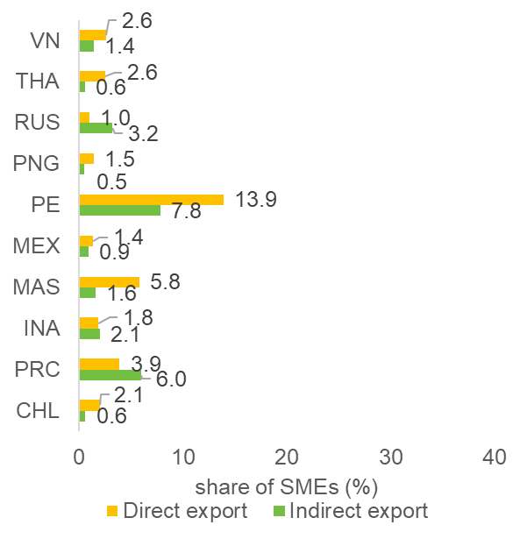
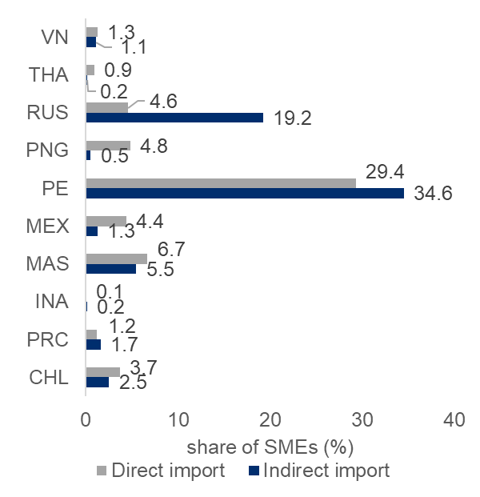
Few SMEs are involved in international trade so far
Share of SMEs reporting exporting and importing activities
In general, the share of SMEs participating in international trade is very low.
SMEs participate in trade directly or indirectly:
By buying/selling goods and services directly
Indirectly, through parts of components of final goods traded by other firms, or through trade in goods using intermediaries.
Participating SMEs tend to be upstreamers (e.g. by sourcing raw materials, inputs, components to manufacturers)
note: data for CHL and MEX were from 2010; data for PRC was from 2012; data for INA, PNG, and VN were from 2015; data for THA was from 2016; data for PE was from 2017; data for MAS and RUS were from 2019.
Source: World Bank Enterprise Survey, 2021

Slide 3
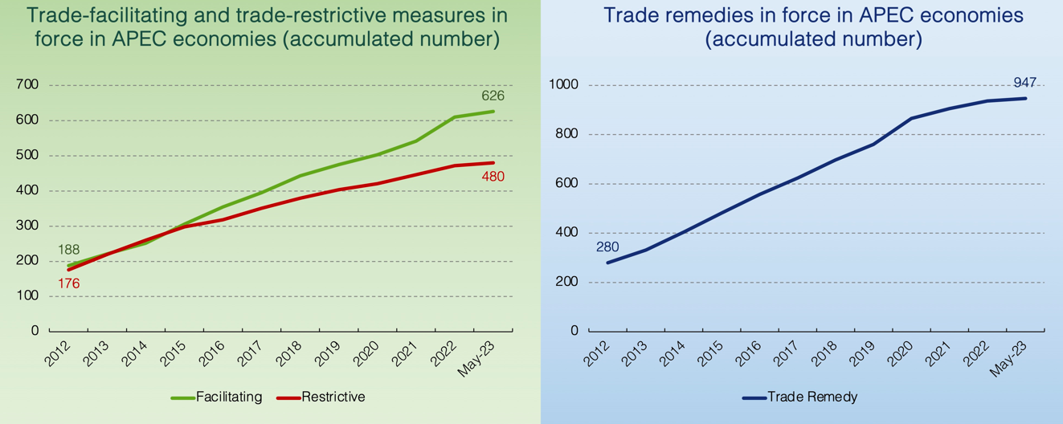
Accumulation of barriers to trade are growing SMEs are most affected by non-tariff measures (NTMs) in comparison to larger firms

Slide 4
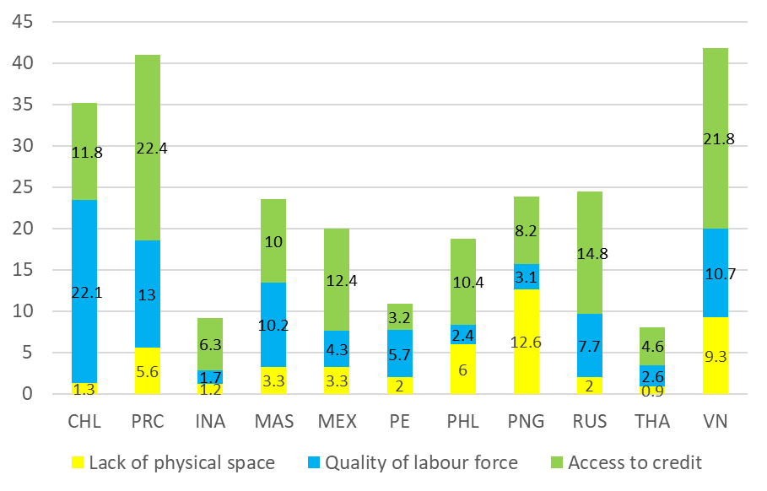
While SMEs could benefit from GVCs, significant internal obstacles constraint their participation in it…
Share of SMEs in APEC economies identifying specific issues as the biggest obstacle (%)
Internal capacities
Lack of know-how
Lack of funds
Lack of physical space
Source: World Bank Enterprise Survey, 2021

Slide 5
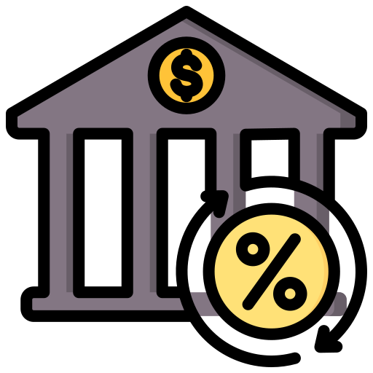
… other obstacles affecting SMEs are related to the cost of doing business…
Average Share of SMEs in APEC economies identifying cost of doing business issues as their biggest obstacle (%)
cost of doing business
Biggest Obstacle | Average Share (%)
Tax administration and rates | 14.3
Corruption | 6.8
Transportation | 6.2
Electricity | 6.2
Labour regulations | 5.6
Business licensing and permits | 3.9
Customs and trade regulations | 2.4
Dispute resolution | 1.1
Tax administration and rates
Transportation
Electricity
Business licensing and permits
Corruption
Customs and trade regulations
Note: Data for CHL and MEX were from 2010; data for PRC was from 2012; data for INA, PNG, and VN were from 2015; data for THA was from 2016; data for PE was from 2017; data for MAS and RUS were from 2019.
Labour regulations
Dispute resolution
Source: World Bank Enterprise Survey, 2021

Slide 6
… and finally sociopolitical issues can also be a significant obstacle for SMEs …
Average Share of SMEs in APEC economies identifying sociopolitical issues as their biggest obstacle (%)
Sociopolitical issues
Practices of the informal sector
Biggest Obstacle | Average Share (%)
Practices of the informal sector | 17.0
Political instability | 7.8
Social unrest | 5.5
Political instability
Social unrest
Note: Data for CHL and MEX were from 2010; data for PRC was from 2012; data for INA, PNG, and VN were from 2015; data for THA was from 2016; data for PE was from 2017; data for MAS and RUS were from 2019.
Informality is one of the main issues affecting SMEs. Unfair competition by informal actors is an impediment for formal SMEs to develop their businesses and grow.
Source: World Bank Enterprise Survey, 2021

Slide 7
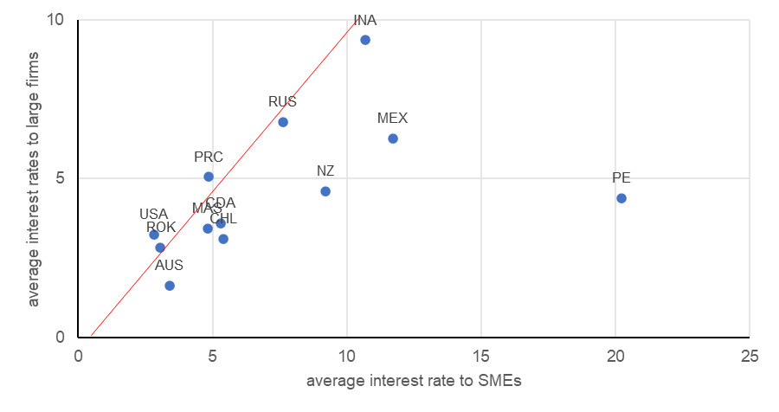
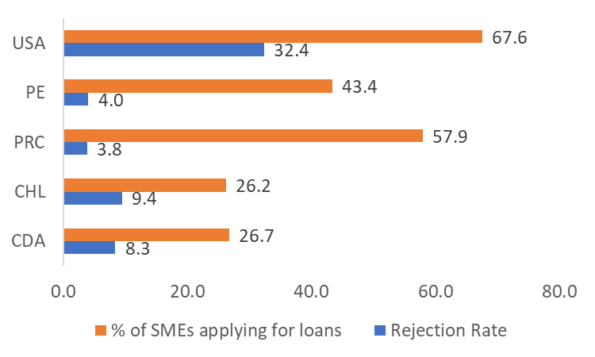
Example of obstacles affecting SMEs participation in GVC: Limited access to credit and at a higher borrowing cost …
Average interest rates to firms in APEC economies, 2020
SMEs loan application and rejection rate, 2020
Note: Data for CDA and NZ were from 2019 and 2016 respectively.
Note: Data for CHL was from 2017 while CDA, ROK, and PE were from 2019.
Obtaining external financing is relatively costly for SMEs
SMEs on average are charged with higher interest rate, 2.9 percentage points on loans relative to larger firms
Problems often compounded by strict requirements set up by banks or financial institutions
Source: OECD, 2023
Notes:
Note to CAK: Please be careful when editing figure A. The 45 deg. line will change position because it’s not a graph, but a shape.
Banks which provide credits for SMEs often ask for prohibitive requirements which in most cases cannot be met by these businesses (audited financial statements, tax returns, collateral requirements, etc.).
Please do note that by being to the right side of the 45 deg. Line, SMEs in these economies bear higher borrowing cost than larger firms.
Reference
[1] IFC, 2017. https://documents1.worldbank.org/curated/en/653831510568517947/pdf/121264-WP-PUBLIC-MSMEReportFINAL.pdf
[2] IFC, 2017. Financing Gap data dashboard: https://www.smefinanceforum.org/data-sites/msme-finance-gap
[3]

Slide 8
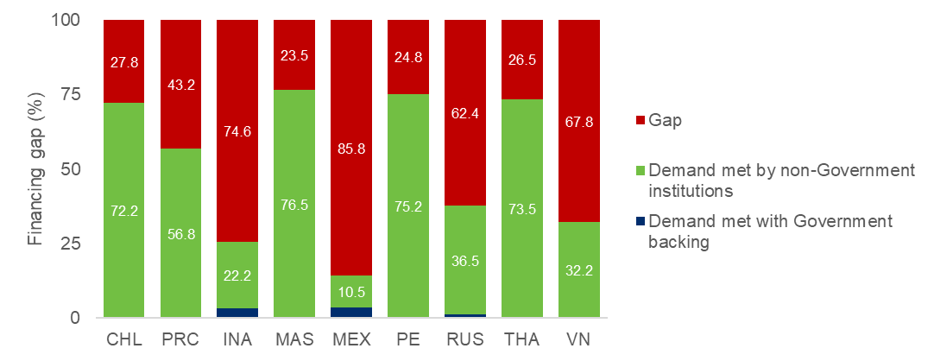
Example of obstacles affecting SMEs participation in GVC: Credits available to SMEs are not meeting demand…
SMEs unmet credit demand, 2017 (% of demand)
Demand for financing from SMEs is quite high and credit sources are mostly insufficient.
Estimates in 9 APEC economies put the financing gap totaling approx. USD 3.19 trillion
Source: IFC, 2017

Slide 9
Role of International Cooperation
Constrained access to financing mostly due to information asymmetry, thus policies should be directed at addressing this issue
What can international cooperation do to improve financial inclusion for SMEs?
To promote transparency supporting:
Solid regulation to establish solid credit information bureau systems
Digitizing SMEs transactions in supply chain platforms and leveraging data on SMEs online activities
Faster assessment of SMEs credit-worthiness
Less physical documentation
SME factoring systems to provide alternative sources of funding via accounts receivable
Difficult requirements
Lengthy and uncertain process
High cost of borrowing
Rejection concerns
Low turnover
Insufficient loan amounts
Higher credit risk
Higher lending cost
Lower revenue-cost ratio
Customer retention problem

Slide 10
Role of International Cooperation
Promoting best practices for regulatory tiering to facilitate SMEs activities. Regulatory compliance can be a major obstacle for many SMEs
Differentiated treatment could be helpful for SMEs. For example:
In Singapore, companies with annual turnover and assets below SG$10 million are exempted from statutory auditing requirements
Regulation affecting SMEs
Regulation affecting companies serving SMEs
In the Philippines, mandatory credit allocations, 2%-8% of banks’ portfolio has to be put in place for SMEs.
Flexible schedules instead of modifying substance in regulations
In Canada, small firms report on Goods and Services Tax on an annual basis, medium-sized firms on a quarterly basis and large firms on a monthly basis.
Regulation facilitating SME access to instruments
In China, utility patent models help SME to cover incremental innovations.

Slide 11
Role of International Cooperation
Access to information is important for SMEs.
Comprehensive supplier and client databases / market information / statistical figures
Ensuring consistent and more resilience supply chain
Financing can be better linked to actual production/demand
Reduce information search costs for SMEs
Speed up the process of obtaining certifications for SMEs

Slide 12
Role of International Cooperation
Collective actions needed to resolve issues affecting firms (particularly SMEs)
Tariffs continue to fall, but NTMs are on the rise
SMEs are less-prepared for major disruptions
Trends of consolidating sourcing to smaller number of larger firms
How to ensure SMEs upgrading along the chains
Problems
Examples of actions needed
Promotion of trade liberalization and facilitation
Agreements to keep supply chain lines open and functional
Competition policy systems, promoting links between SMEs and larger firms
Access to capital, skill development initiatives

