Slide 1
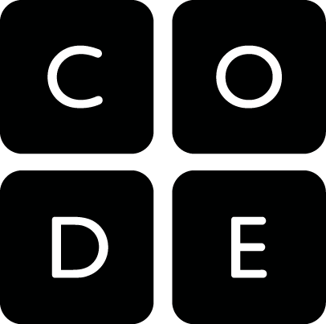
Doyeon Kim
Head of Partnerships, APAC

Slide 2
OUR VISION
every student
in every school
has the opportunity
to learn computer science

Slide 3
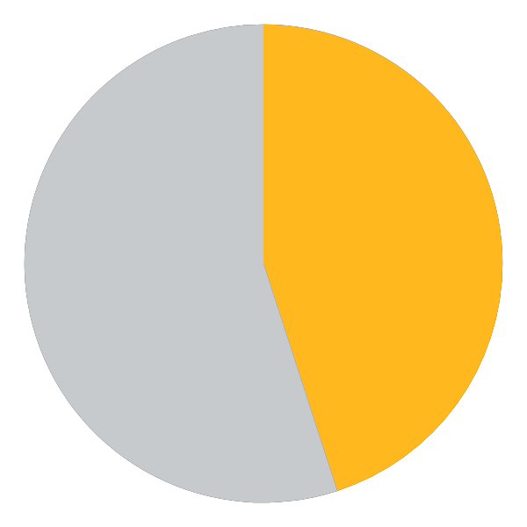
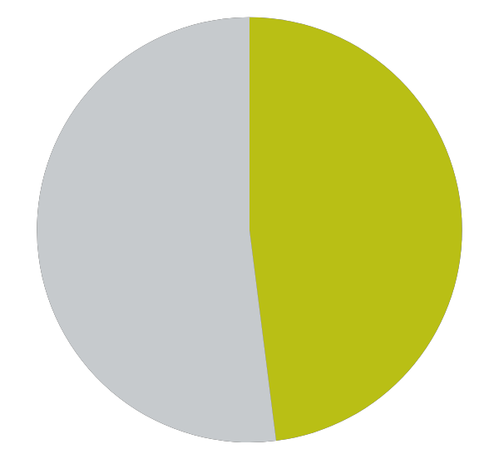
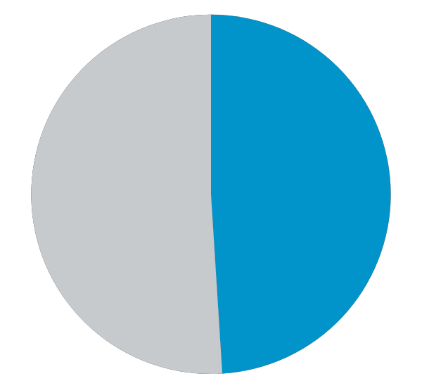
80M students
2.5M teachers
in 70+ countries
45%
Female
students
50%
Under-
represented
groups
46%
Students in high needs schools
Notes:
Over 30M student accounts outside of the US
Our courses are translated into over 30 languages.
We are the number one provider of computer science curriculum in the US and the world - and it is all free!
https://code.org/promote/diversitydata
https://code.org/about/2021

Slide 4
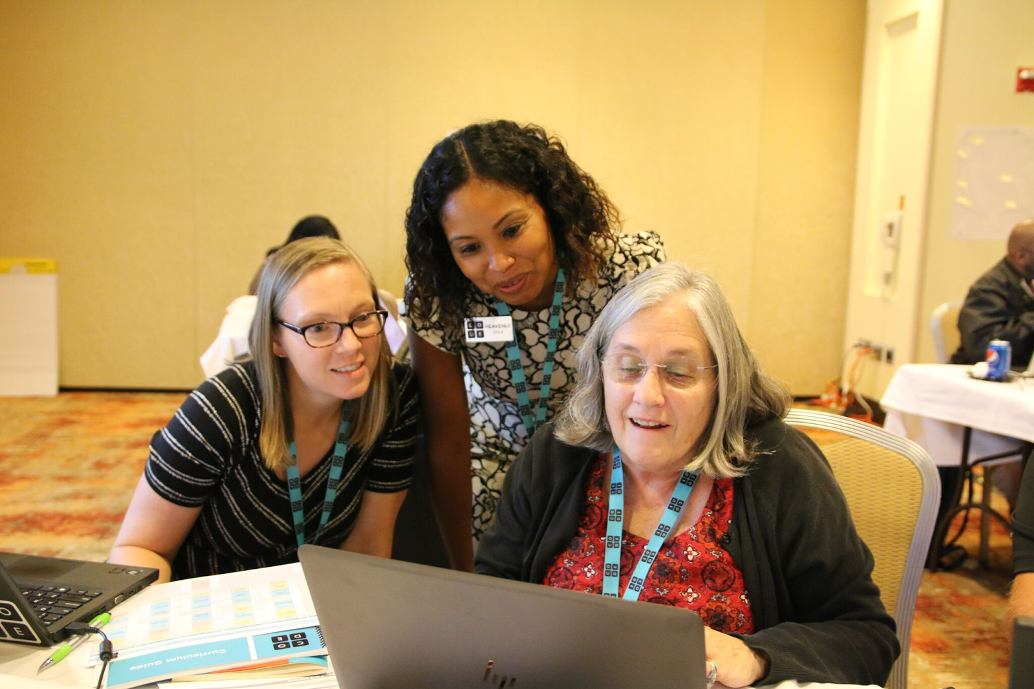
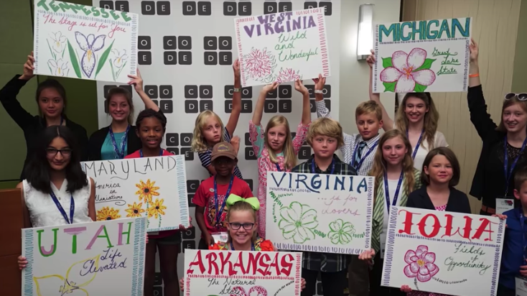
Promote CS
Professional Learning
Every Student, Every School
Curriculum
Policy

Slide 5
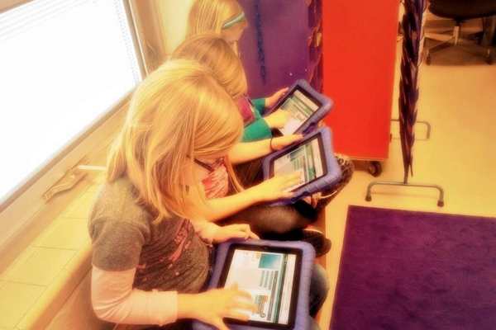
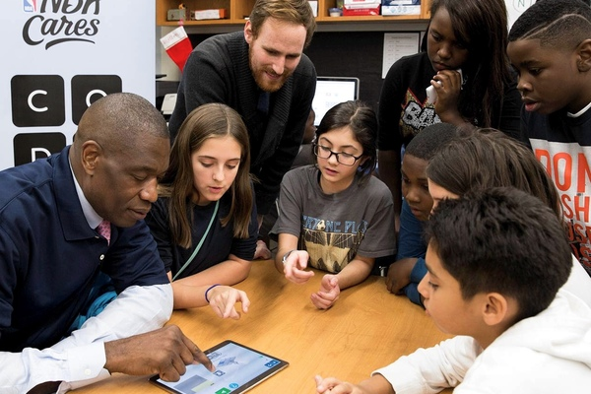
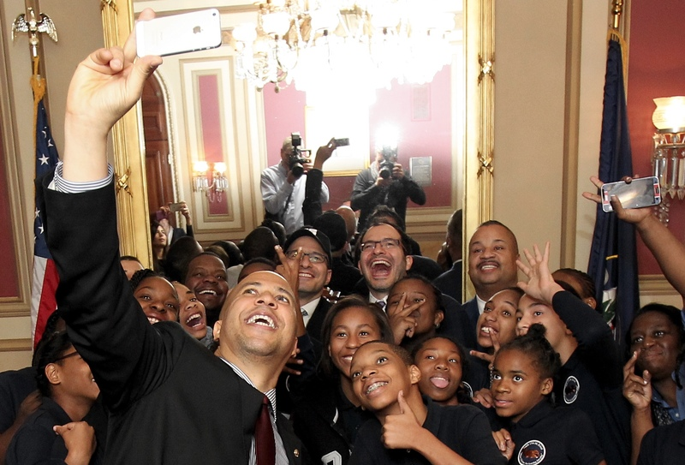
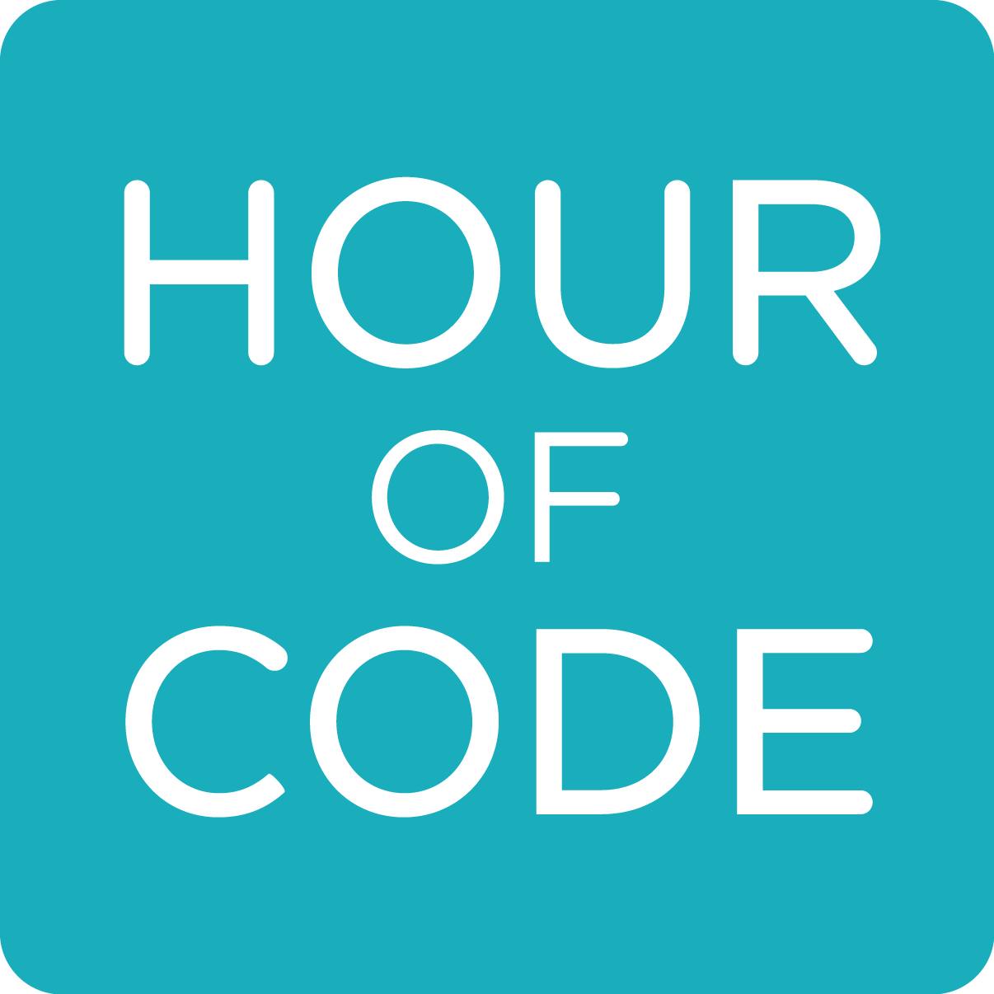
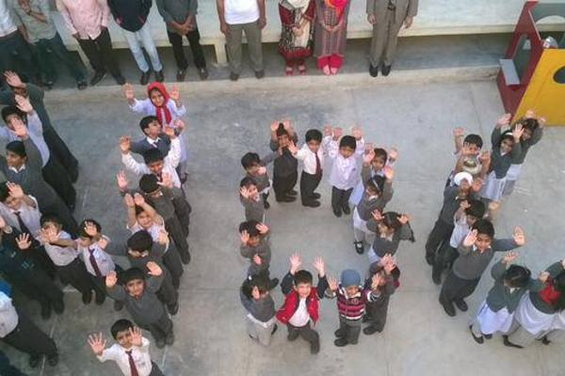
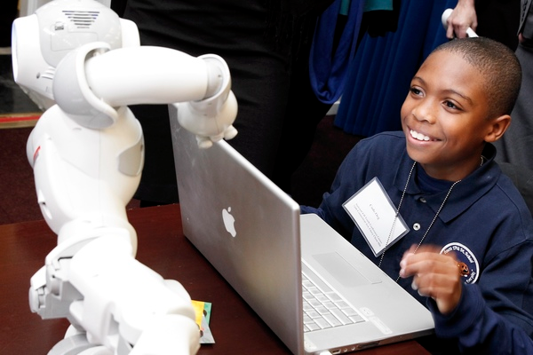
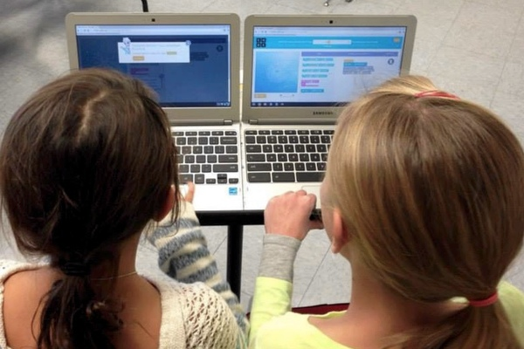
Hour of Code — one-hour introduction to computer science, using fun tutorials to show that anybody can learn the basics

Slide 6
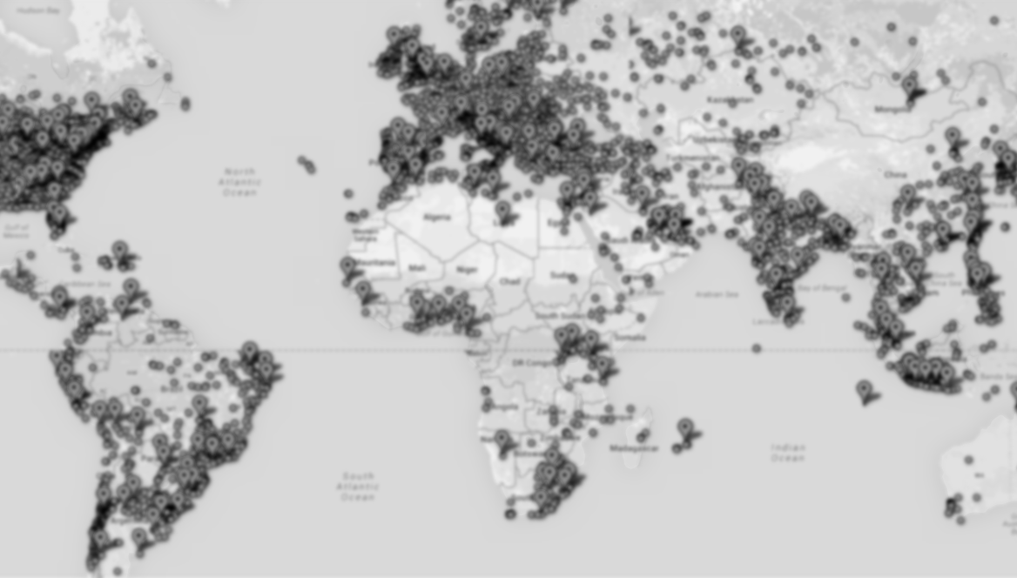
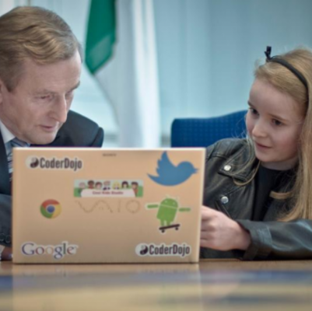
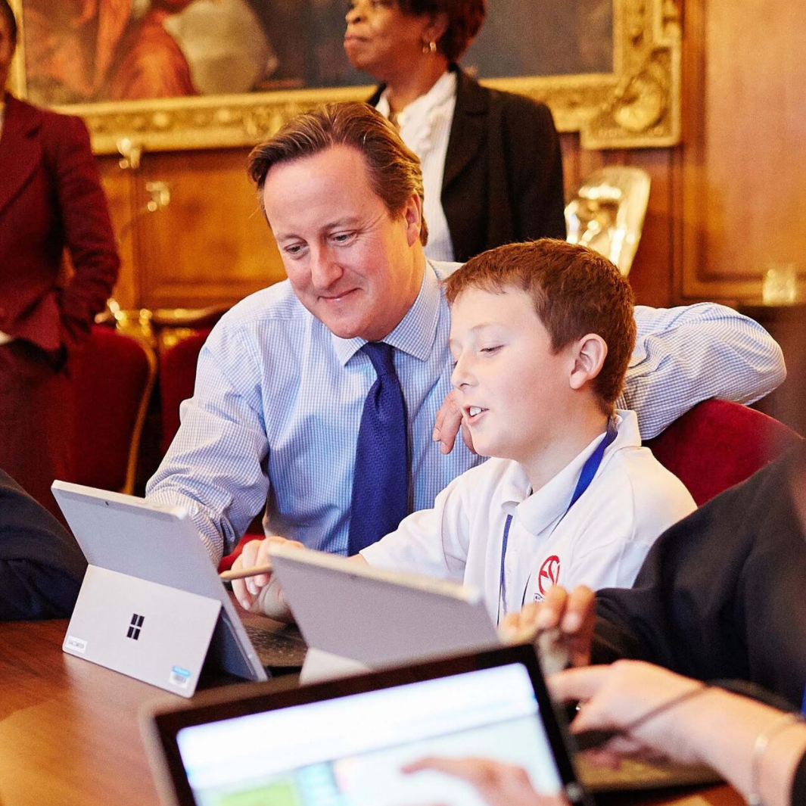
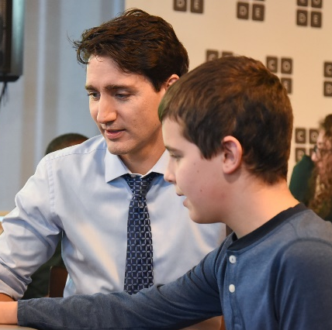
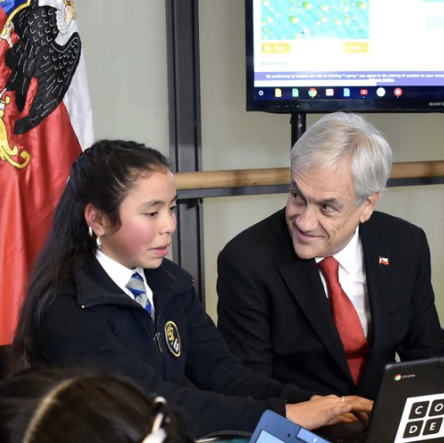
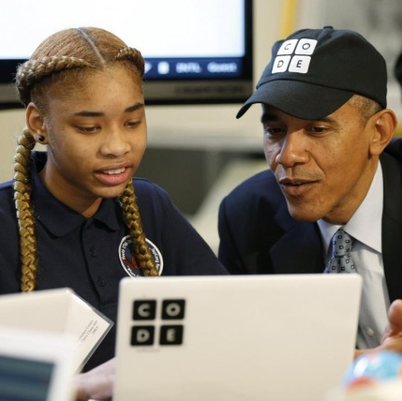
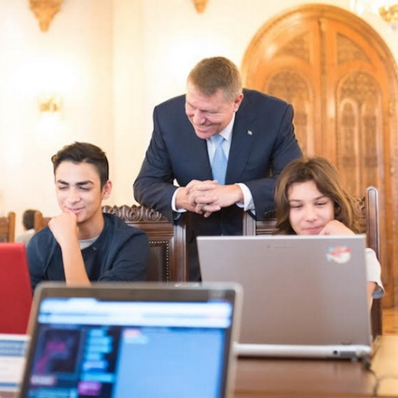
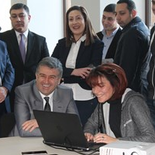
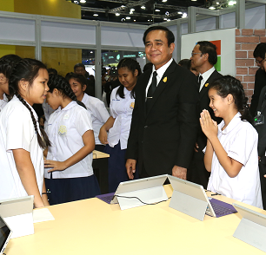
Notes:
Jamaica, Chile
UK, Armenia
Ireland, US
Canada, Thailand
Taiwan, Romania
Spain

Slide 7
Agenda
Examples of APAC countries
NWS, Australia
India
Japan
Singapore
South Korea
SEAMEO
Policies to make Computer Science foundational (USA)
Notes:
NWS, Australia - Equity
India - PPP
Japan - Informatics Education Policy
Singapore - AI in Education
South Korea - CS Curriculum

Slide 8
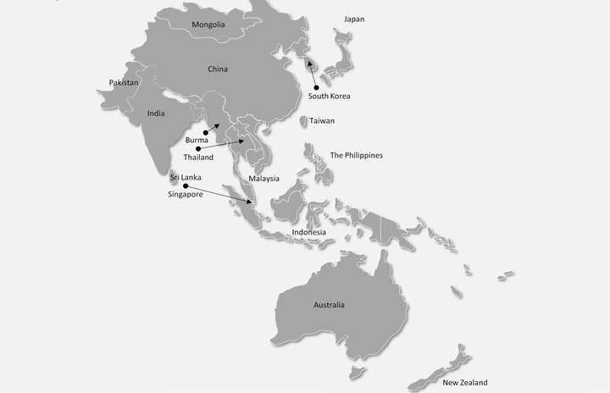
Asia-Pacific Region

Slide 9
NSW, Australia - Equity in Digital Literacy
Addressing the second digital divide for students
First digital divide: Gap between those who have access to infrastructure and the internet and those who cannot
Second digital divide: Gap between those who have digital competencies and those who do not have
‘Bump It Up’ Program
To support disadvantaged students and their families
To implement locally developed targeted initiatives
To help disadvantaged students improve their digital literacy skills and overall education outcomes

Slide 10
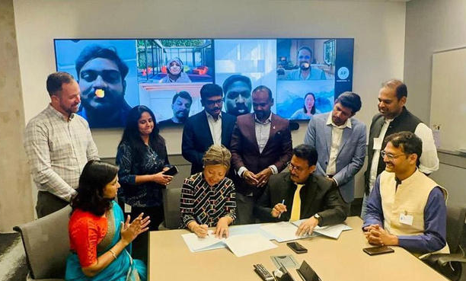
India - Public Private Partnership
Tamil Nadu pact: Partnership with the Ministry of Education, a corporate, and nonprofits
Microsoft’s Technical Education and Learning Support (TEALS) program
To provide computer science training for 300 teachers to reach over 3 million students
Code.org’s local NGO to use CS Discoveries curriculum
Source: https://www.msn.com/

Slide 11
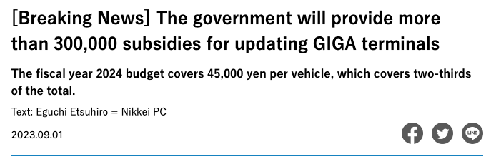
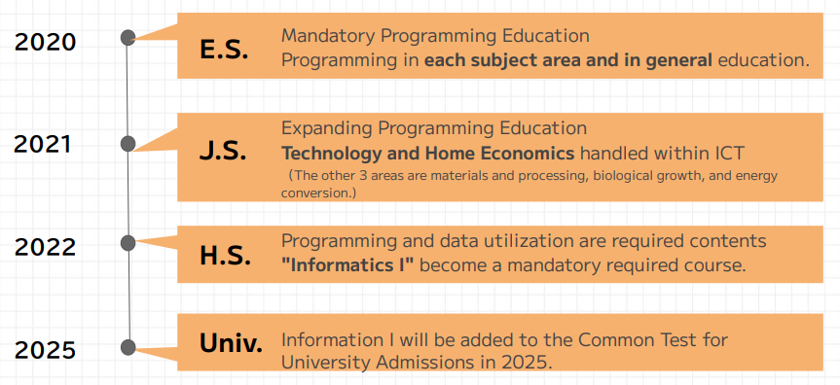
Japan - Recent Changes in Informatics Education
GIGA* School Initiative
Ensuring ‘1 device for 1 student’ with a high-speed network
Ministry of Education secured 2024 budget to upgrade devices
Cultivating the abilities to utilize ICT
To be positioned as the ‘fundamental ability for learning for all students’
Improving Informatics education
Mandatory and expanded in primary and secondary schools
*GIGA: Global Innovation Gateway for Al (launched in 2019)
Source: Minna No Code, Code.org’s international partner

Slide 12
Singapore - AI in Education to Help Students’ Learning
Student Learning Space (SLS)
Centerpiece of MoE’s education technology strategy
Alignment with the national AI strategy
To provide personalised education, tailored to individual strengths and weaknesses
Collaboration between academic, public, and private sectors
AI Centre for Educational Technologies (AICET)
Sources: https://www.moe.gov.sg/ | https://www.learning.moe.edu.sg

Slide 13
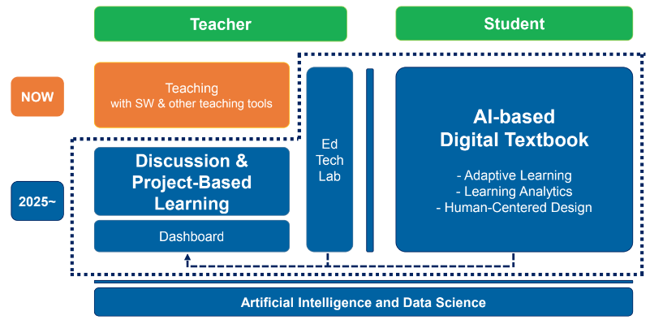
South Korea - Computer Science Curriculum for K12
CS curriculum revised in 2022
Elementary school: Mandatory, 34 hours per year, for 2 years; AI incorporated
Middle school: Mandatory, 68 hours per year, for 1 year
High School: Optional, 68 hour per year, up to 3 years; AI and ML, data science, security, algorithm, etc.
AI-based digital textbook from 2025
Adaptive learning
Learning analytics
Human-centered design
Source: KOFAC, Code.org’s international partner

Slide 14
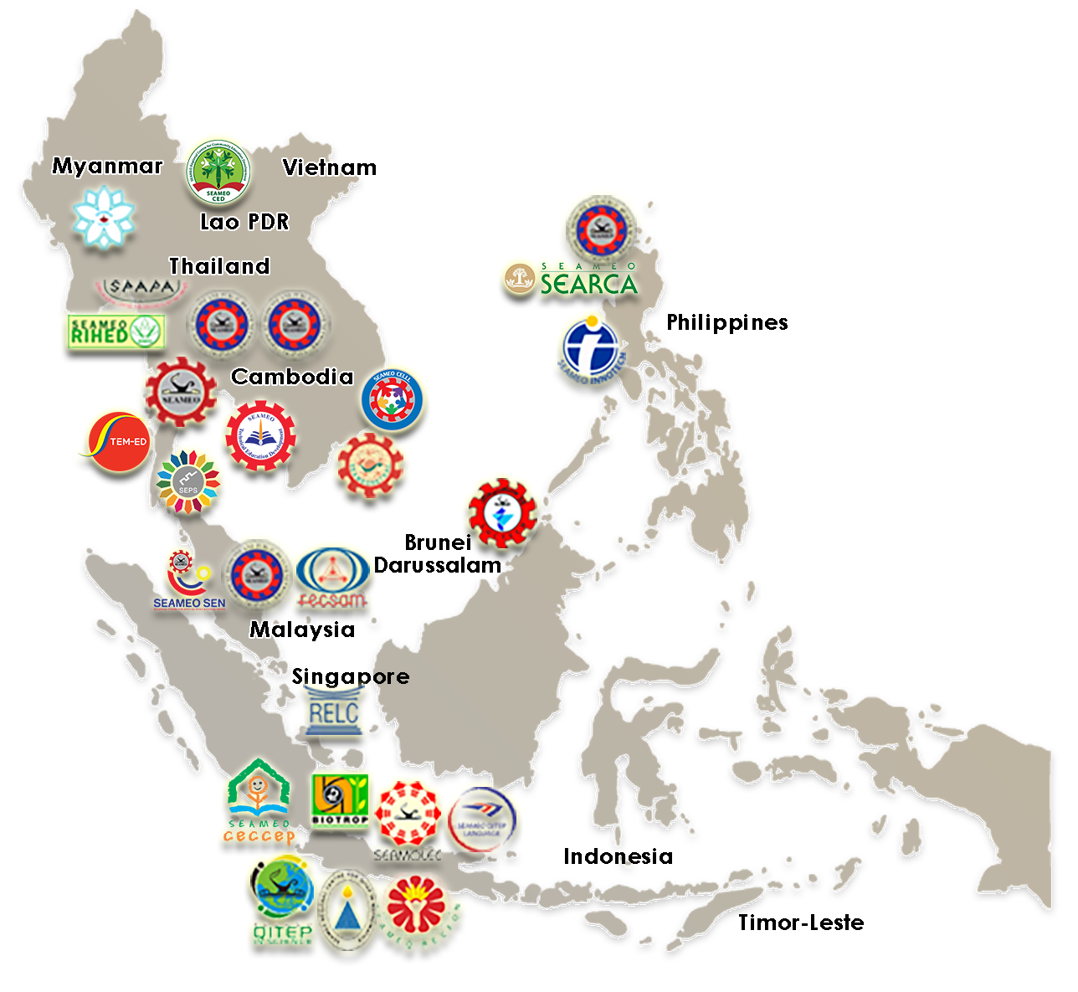
SEAMEO - Collective Leadership
SEAMEO (The Southeast Asia Ministers of Education Organization) is an intergovernmental organization of the 11 Southeast Asian countries*
26 Regional Centres
SEAMEO has 26 specialist institutions that undertake training and research programmes in education, science, and culture.
Each regional centre has a Governing Board composed of senior education officials from each SEAMEO member country.
Source: https://www.seameo.org/
*SEAMEO member countries Brunei, Cambodia, Indonesia, Lao PD, Malaysia, Myanmar, Philippines, Singapore, Thailand, Timor-Leste, Vietnam

Slide 15
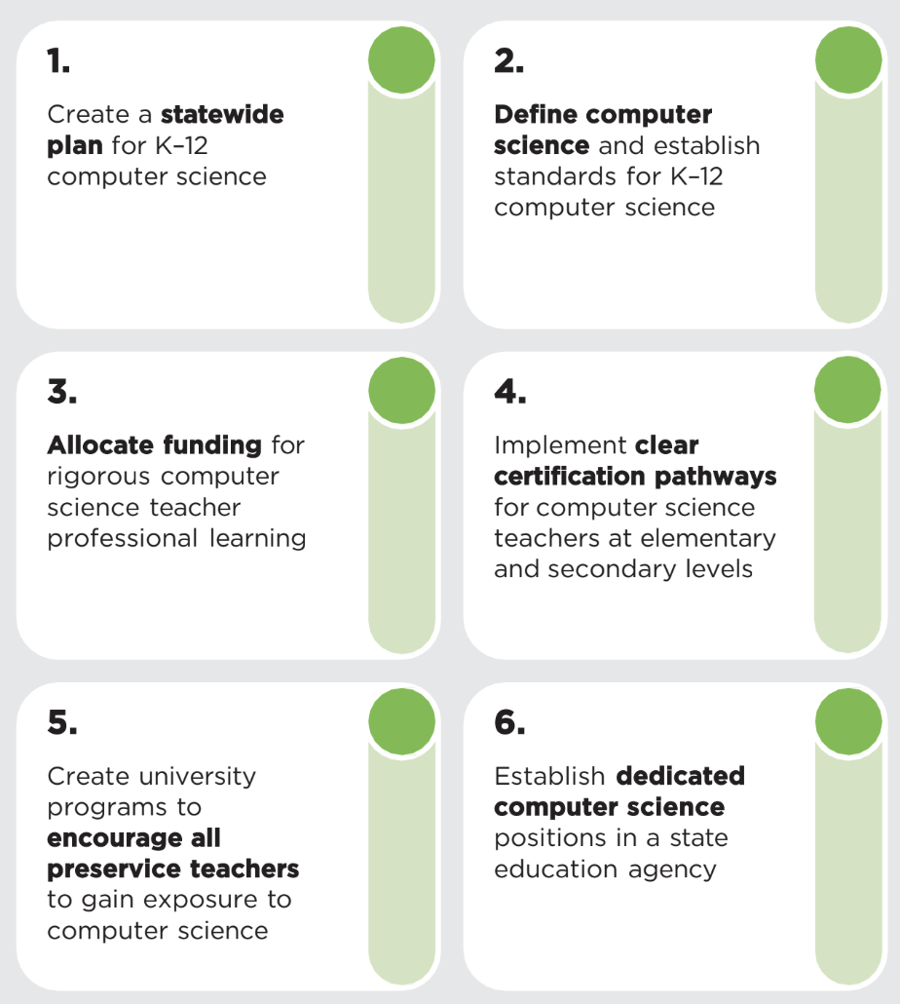
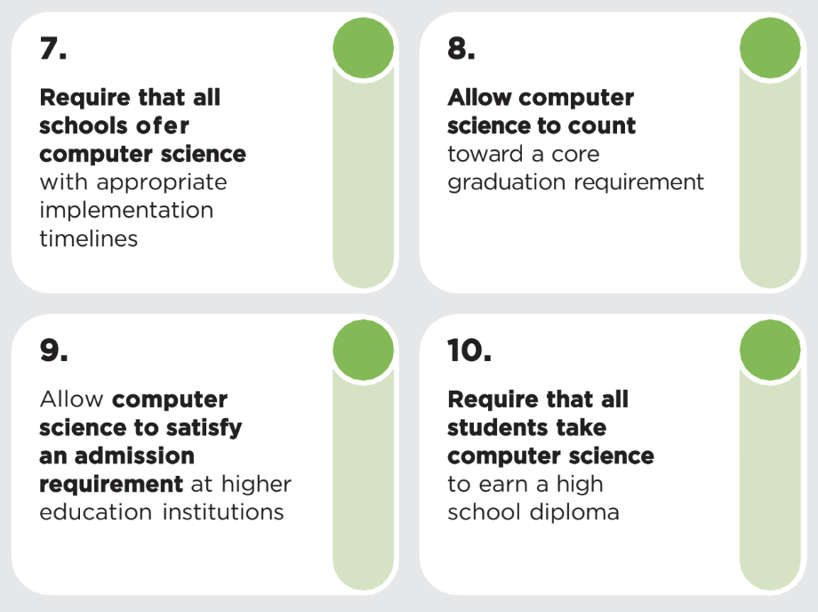
Ten Policies to Make Computer Science Foundational(USA)
Notes:
A holistic approach will require a cross organization effort
We will embrace these tenets to guide our team, and our work:
Leadership. We will actively lead through our opinions, perspectives, and actions on the what, when, and how of AI education (i.e. product, curriculum, frameworks, and standards).
Stewardship. We will galvanize coalitions, and evangelize a holistic, inclusive (i.e. academia, and industry), and learning-centered approach to AI education.
Innovation. We will apply AI in our products in order to improve student learning outcomes at scale.

Slide 16
THANK YOU!
Doyeon Kim
Head of Partnerships, APAC
doyeon.kim@code.org

