Slide 1
SME TRADE AND SUSTAINABILITY
ESG en las Pymes y el Desafío de Avanzar en una Agenda de Sustentabilidad
Kati Suominen, Nextrade Group
25 October 2023

Slide 2
Ecommerce adoption expanding
MSMEs are increasingly engaged in ecommerce
Graduating from social channels to using marketplaces too

Slide 3
Ecommerce is an opportunity for smes to export
Online sellers likelier to export and export to more markets
Larger sellers are especially realizing export gains

Slide 4
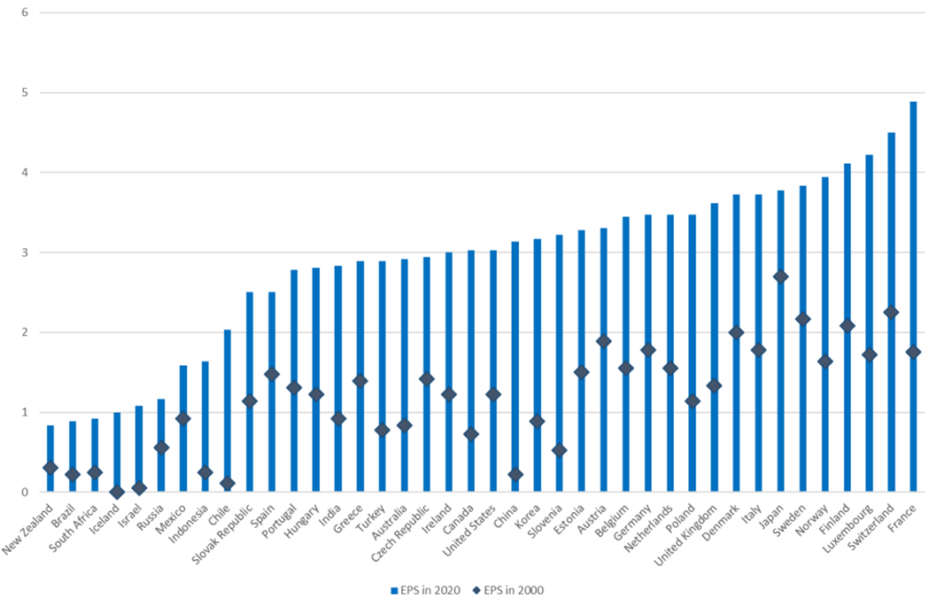
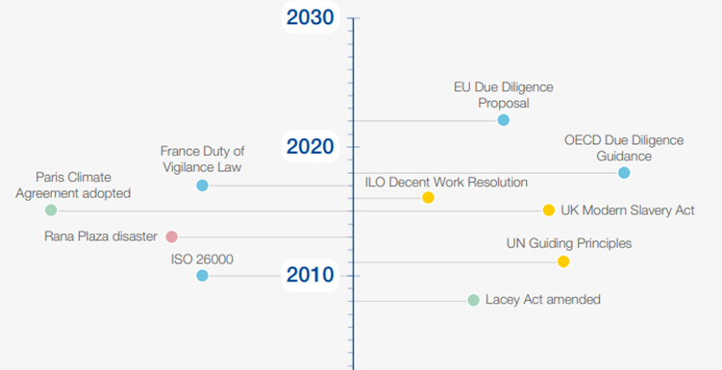
NEW CHALLENGES FOR SMES IN TRADE: “GREEN TAPE”
OECD Environmental Policy Stringency
Supply chain sustainability mandate milestones
Source: Nextrade Group survey with Asia-Pacific, African, and MENA micro and small firms

Slide 5
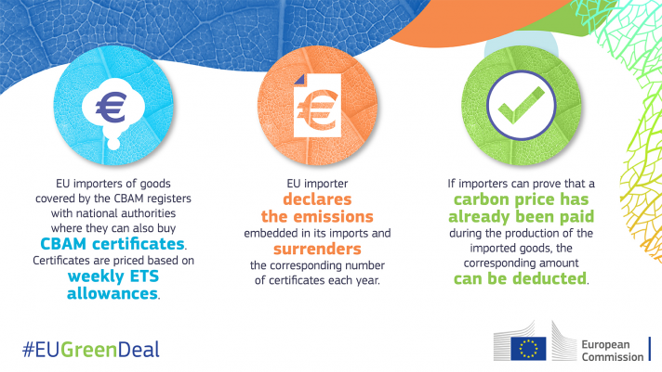
CBAM (Carbon Border Adjustment Mechanism) = import tariff on carbon-intensive goods from outside eu

Slide 6
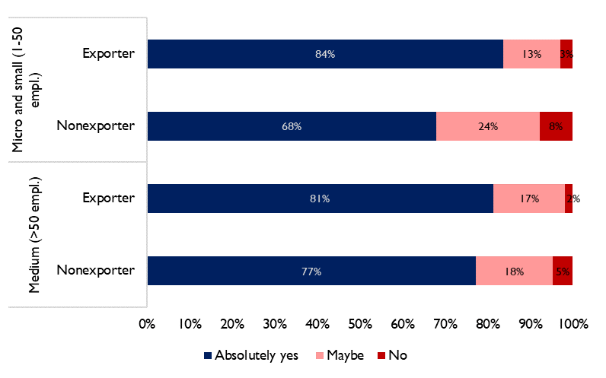
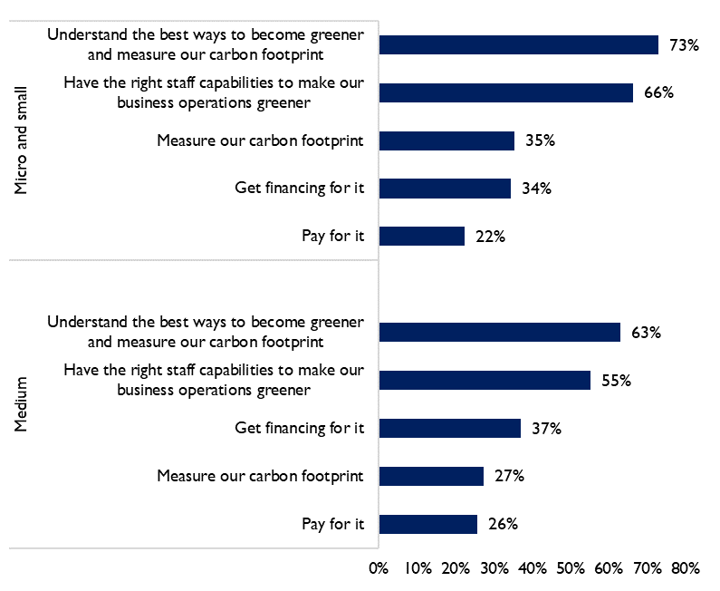
WE FIND: EXPORTERS ARE LIKELIEST TO WANT TO GREEN
SMEs’ desire to “become more environmentally sustainable and green” by firm size and export status
SMEs’ needs to become more sustainable
Source: Nextrade Group survey for UPS, 2023

Slide 7
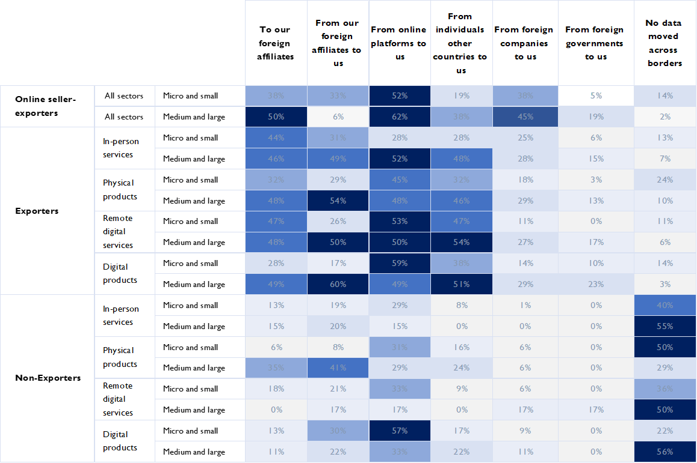
SME and especially online seller - exporters export and import data:
data transfer is critical for SMEs that export using ecommerce
Source: Suominen and Vambell (2021)

Slide 8
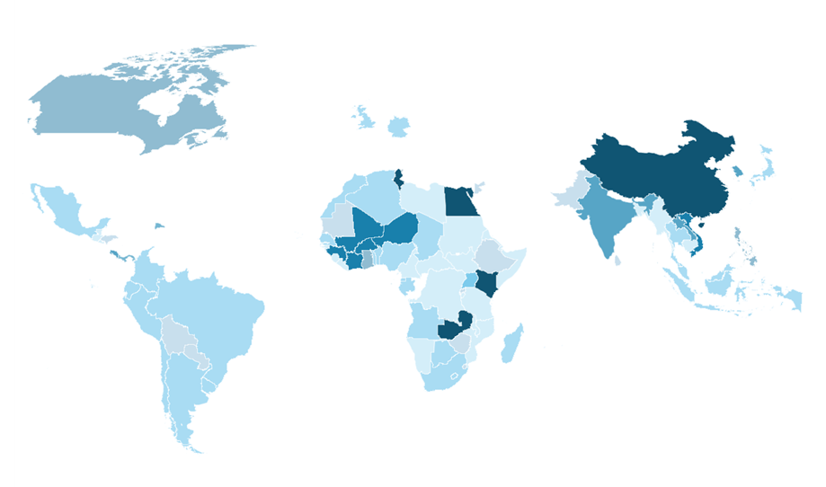
« S» Data privacy and transfer law diversity or «fragmentation» around the world
Source: Suominen and Vambell (2021)

Slide 9
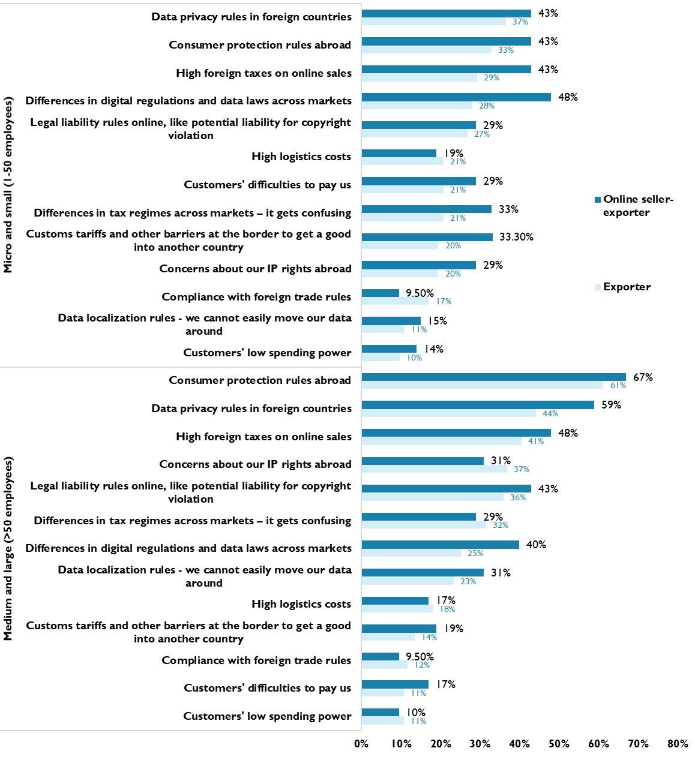
African MSMEs’ main digital policy challenges in exporting products or services online –
Unclear / complex data privacy, tax, and consumer protection rules in foreign markets
Prospect of data localization
Regulatory fragmentation
Source: Suominen and Vambell (2021)

Slide 10
ESP. FAST-GROWING EMERGING MARKET SMEs have FOCUSED ON GREENING
Do you have sustainability / greening targets?
Investments to become more sustainable
Most firms invest ~5% of revenue on sustainability
Source: Nextrade Group survey with Asia-Pacific, African, and MENA micro and small firms

Slide 11
SMEs have REPLACED DIRECTLY OR INDIRECTLY FOSSIL FUEL USE AND CHANGED LOGISTICS VENDORS
Strategies to reduce fossil fuels
Change of suppliers to meet sustainability targets and mandates
Source: Nextrade Group survey with Asia-Pacific, African, and MENA micro and small firms

Slide 12
EMERGING MARKET SMEs have amplified AI use in the past few years
Demands SMEs face for sustainability / greening?
Implications of sustainability / greening mandates
Source: Nextrade Group survey with Asia-Pacific, African, and MENA micro and small firms

Slide 13
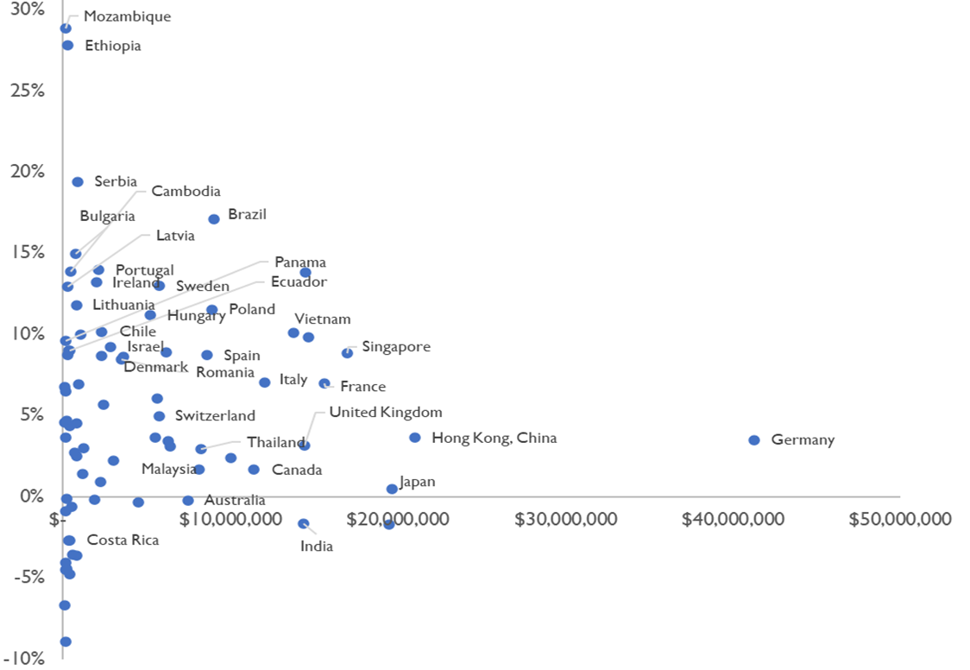
EXPORT OPPORTUNITIES OF COURSE AS WELL - GLOBAL GREEN TECH IMPORT GROWTH IN 2017-21
Source: Nextrade Group

Slide 14
TRADE ECOSYSTEM USED BY SMES ALSO GREENING
Ports around the world are greening
SMART ports = green ports
Examples:
Jeddah: Smart Port Initiative to automate terminal operations through 5G, improved infrastructure, cloud computing services, cybersecurity; Green Port Initiative aims to cut energy consumption by 15 per cent, electrify equipment and phase out diesel
Rotterdam: Digital twins, IoT sensors, digital traceability, use of drones, blockchain system linking logistics and payments, 5G testing; transition to renewable and green energy sources to electrify ports
Shenzhen: Smart Port project applies 5G, IoT, big data, AI and other emerging technologies in port services and operations for automation, efficiency, and intelligent management; includes green and low carbon initiatives
Source: Nextrade Group

Slide 16
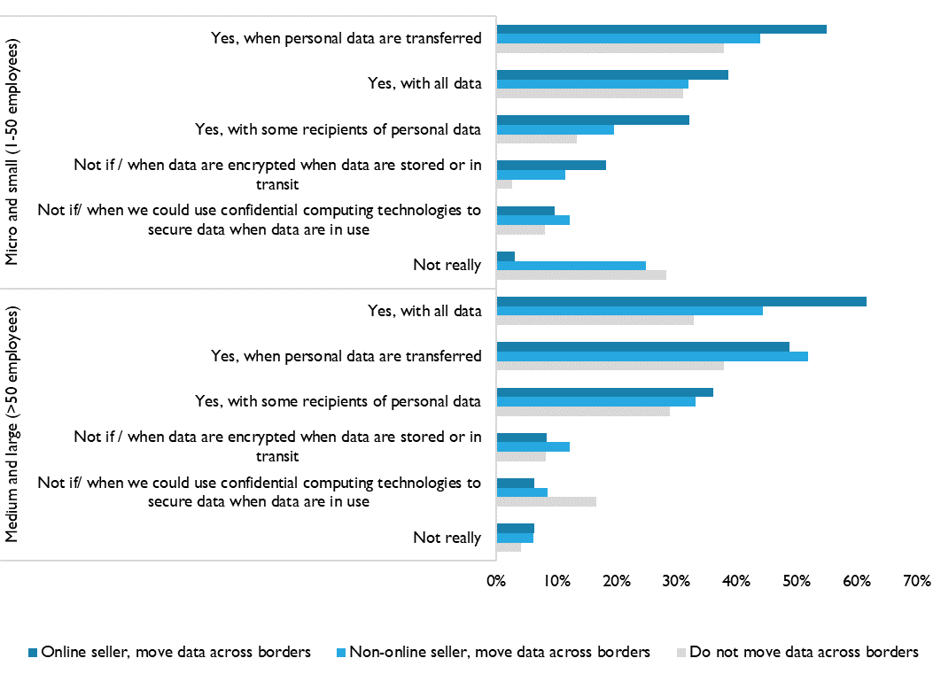
Surveyed African SMES do not take data transfer to third parties lightly
“Are you concerned about how a recipient of the data you transfer uses it?”

Slide 17
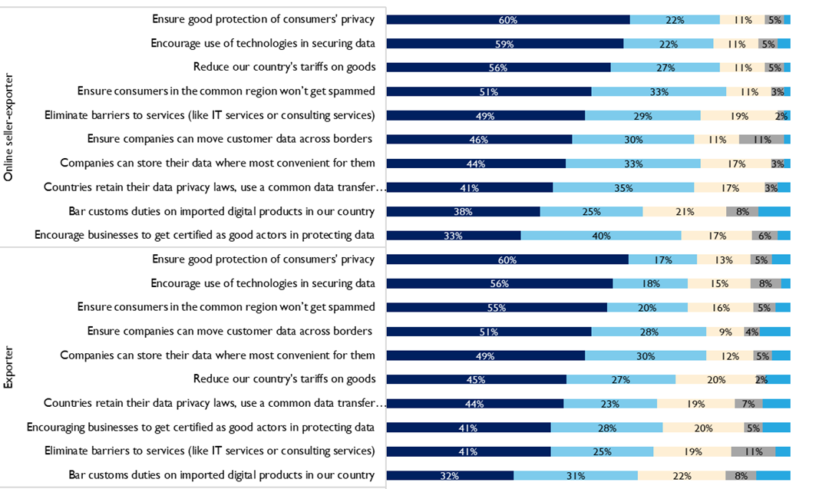
Surveyed African firms want open data regimes and ability to store data where most feasible
Source: Suominen and Vambell (2021)

Slide 18
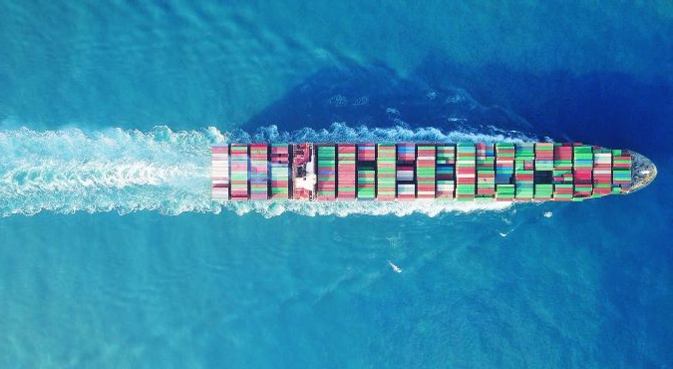
VIDEO SLIDE

Slide 19
GRACIAS
Kati Suominen
Email
kati@nextradegroupllc.com

Slide 20
US is dominant and growing in some large green tech industries (size of bubble: US exports)

